Slide 1
Book Recommendation System
Team 5 :
Team Members
Tapas Kumar Dash
Dausabgari Shaik Salman Basha
Chandana Patro

Slide 2
agenda
● Problem statement
● Data Summary
● Analysis of different datasets
● Outlier treatment
● Imputing missing values
● Different Recommendation Model
● Challenges
● Conclusion

Slide 3

Problem Statement
During the last few decades, with the rise of Youtube, Amazon, Netflix, and many other such web services, recommender systems have become much more important in our lives in terms of providing highly personalized and relevant content.
The main objective is to create a recommendation system to recommend relevant books to users based on popularity and user interests.

Slide 4
Data Summary
The dataset is comprised of three csv files:: User_df, Books_df, Ratings_df
Users_dataset.
● User-ID (unique for each user)
● Location (contains city, state and country separated by commas)
● Age Shape of Dataset - (278858, 3)
Books_dataset.
● ISBN (unique for each book) ● Book-Title
● Book-Author ● Year-Of-Publication
● Publisher ● Image-URL-S
● Image-URL-M ● Image-URL-L
● Shape of Dataset - (271360, 8)
Ratings_dataset.
● User-ID ● Book-Rating
● Shape of Dataset - (1149780, 3) ● ISBN

Slide 5
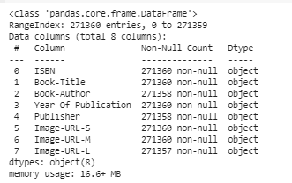
books.info()

Slide 6
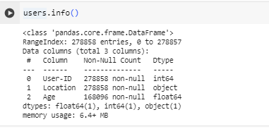
users.info()

Slide 7
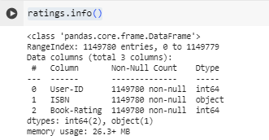
ratings.info()

Slide 8
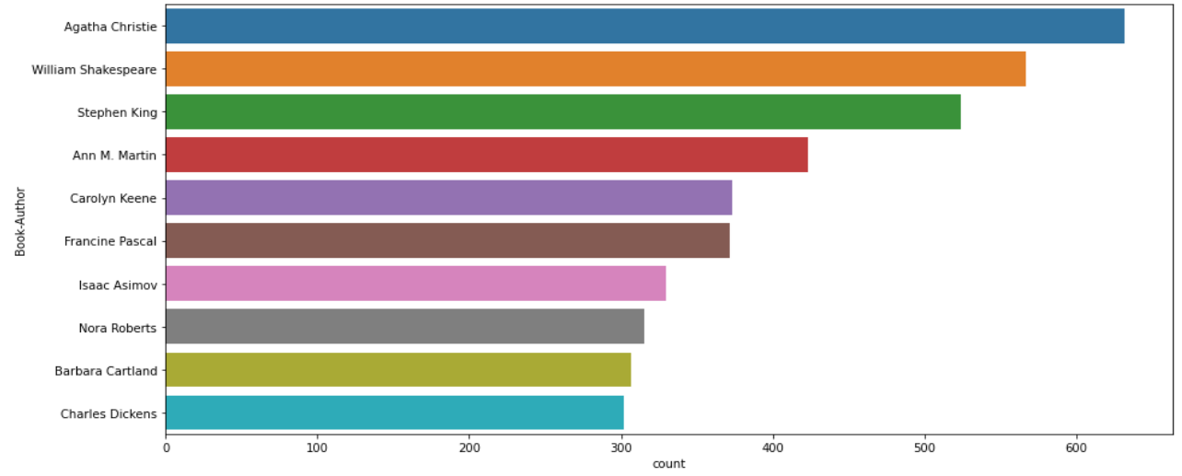
Observations from Book_df (Authors)
Agatha Christie wrote highest number of books in our given dataset

Slide 9
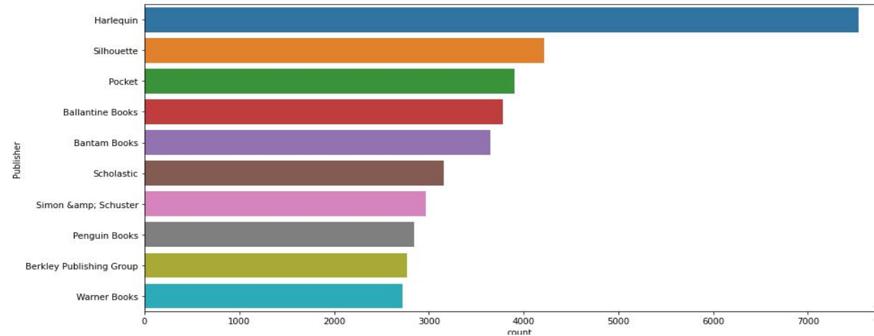
Observations from Book_df (Publishers)
Harlequin published highest number of books in our given dataset

Slide 10
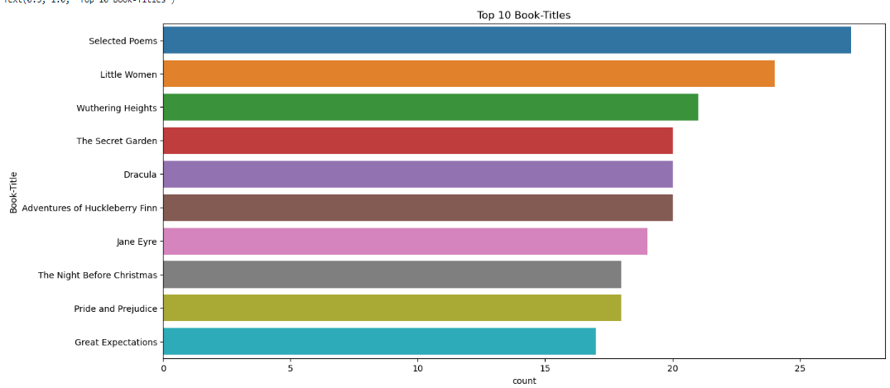
Observations from Book_df (Book-Title)
Selected Poems rated highest among the book title in our given dataset.

Slide 11
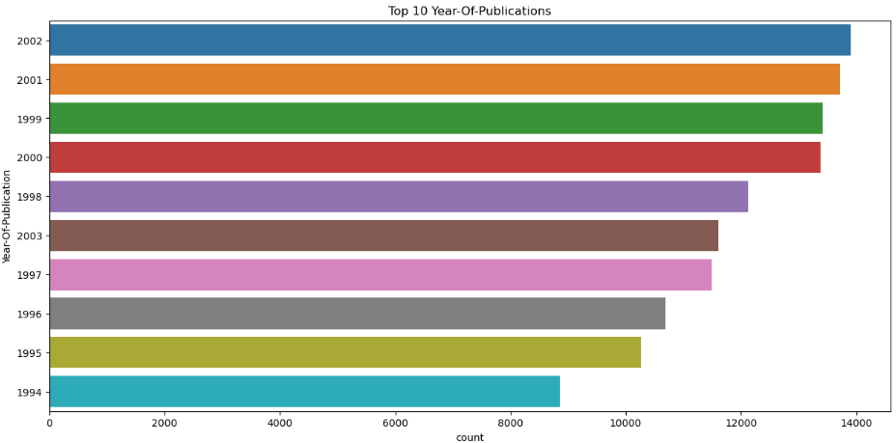
Observations from Book_df (Year-of-Publication)
2002 is rated highest year-of-publication in our given dataset.

Slide 12
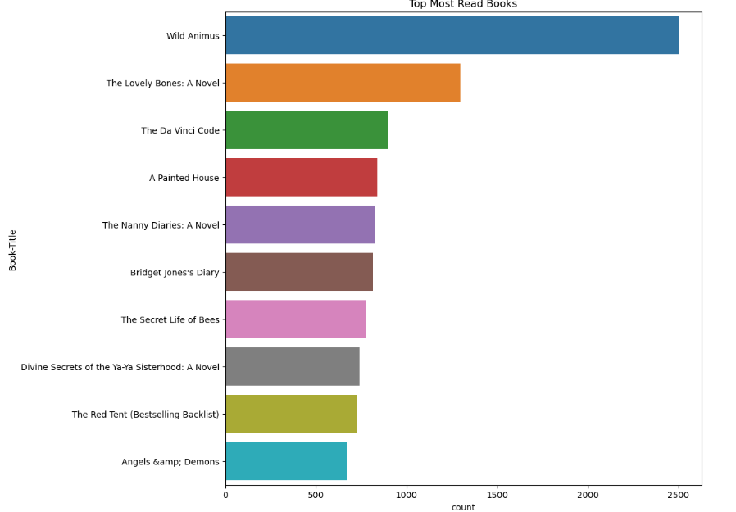
Observations from Book_df (Top most book read)
Wild Animus rated as top most read books in our given dataset.

Slide 13
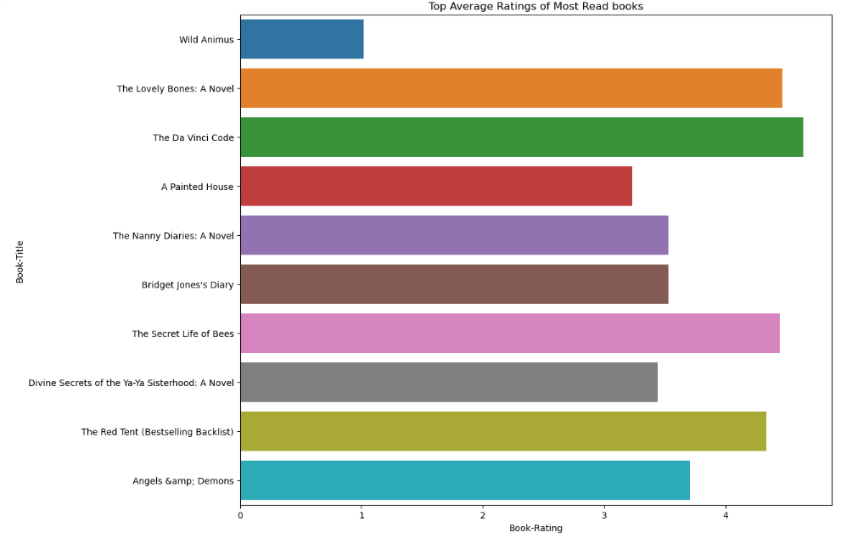
Observations from Book_df
Display the top 10 books with the highest average ratings among the most read books.

Slide 14
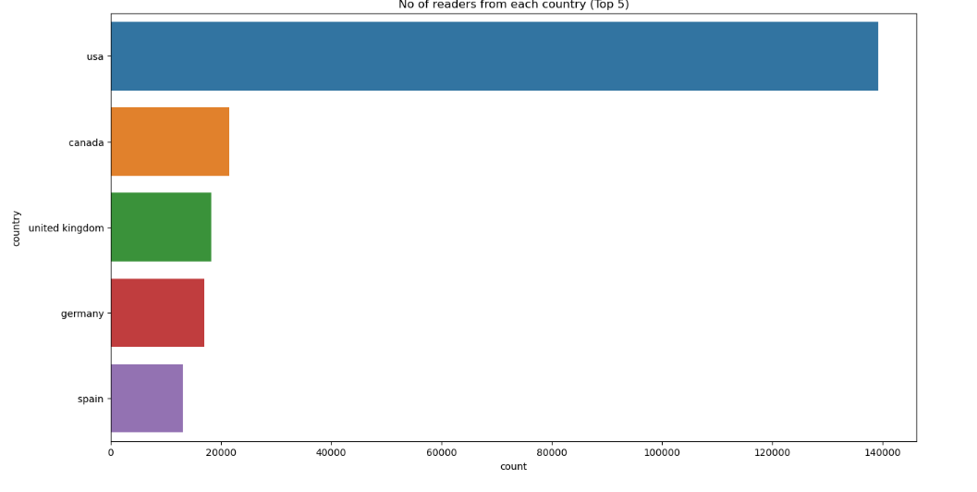
Observations from Book_df
No of readers from each country (Top 5)'

Slide 15
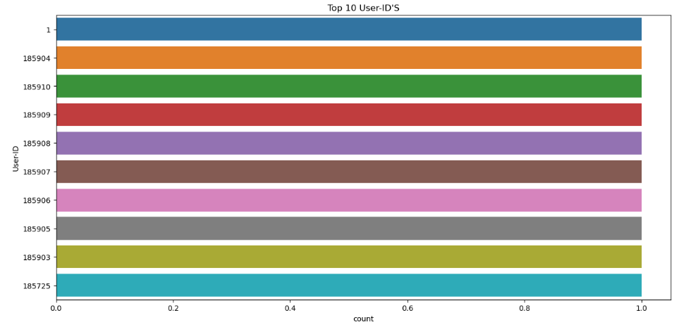
Observations from User_df
Top 10 User’s from users Dataframe.

Slide 16
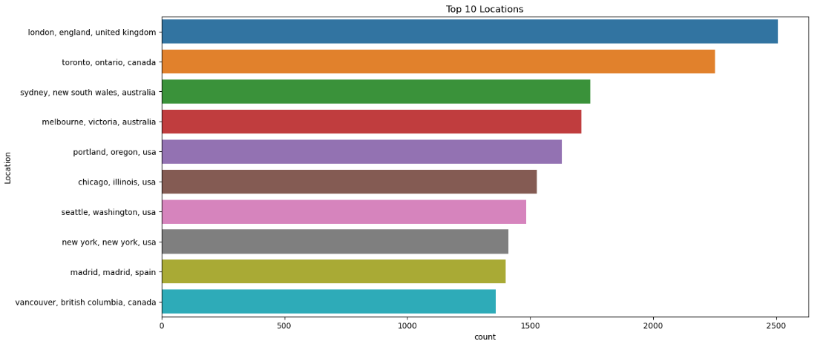
Observations from User_df
Top 10 Locations from users Dataframe.

Slide 17
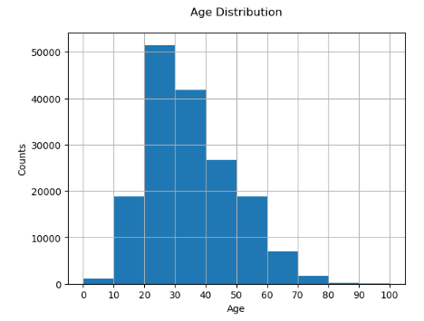
Observations from User_df
● The Age range distribution is right skewed.
● Most active readers lie in age group 20- 40

Slide 18
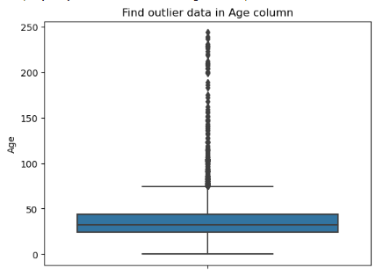
Imputing missing values
● Outliers in Age column
● Age has positive Skewness (right tail) so we can use median to fill Nan values,

Slide 19
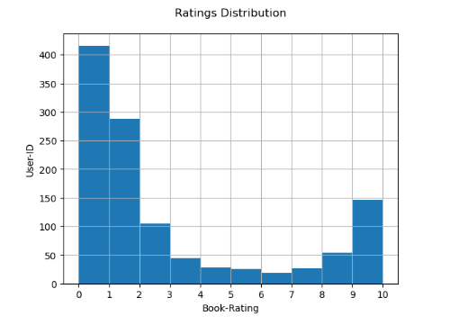
Ratings Distribution

Slide 20
Different Models
1.) Popularity Based Recommendation Book weighted average formula:
Weighted Rating(WR)=[vR/(v+m)]+[mC/(v+m)]
Where, v is the number of votes for the books;
m is the minimum votes required to be listed in the chart; R is the average rating of the book;
C is the mean vote across the whole report

Slide 21
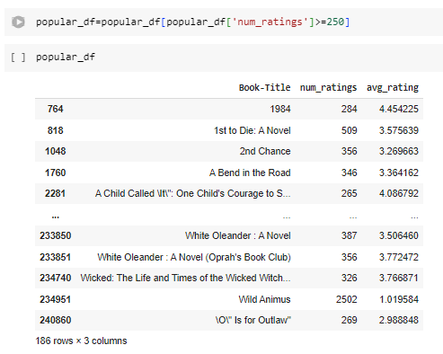
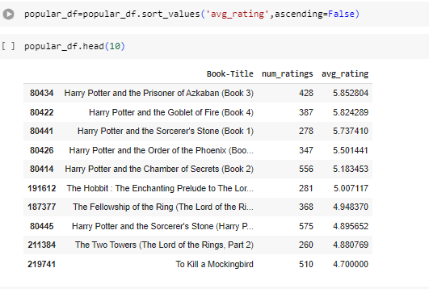
Popularity Based Recommendation

Slide 22
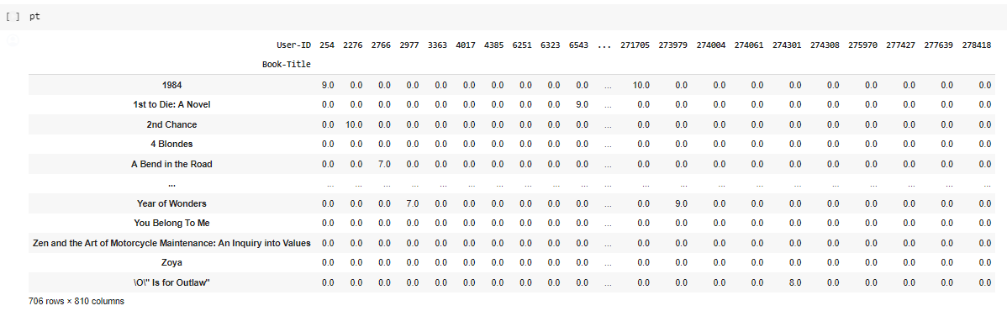
Matrix table

Slide 23
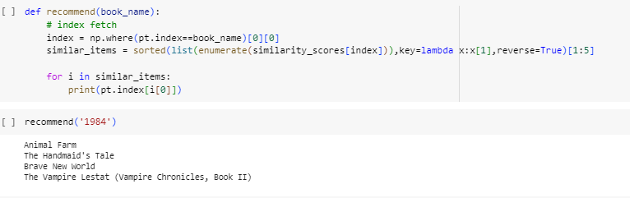
Item-Based collaborative system
It works by analyzing the behavior and preferences of similar users and providing recommendations based on their past interactions with items.

Slide 24
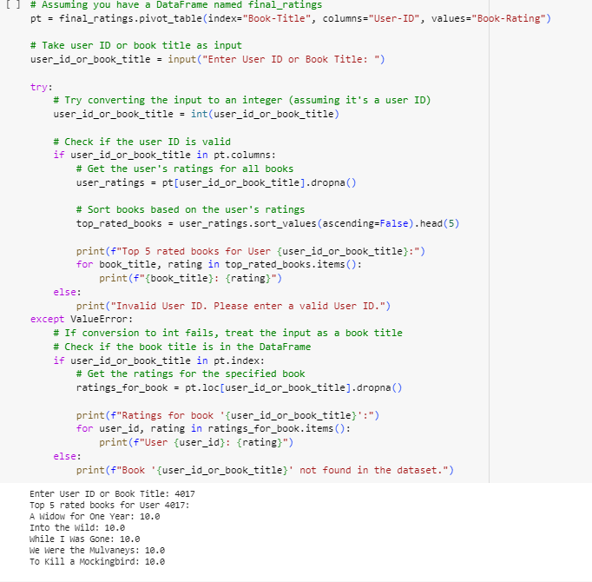
User-Based collaborative system
The idea is to leverage the similarity in user behavior to find similar users and recommend items that similar users have liked.

Slide 25
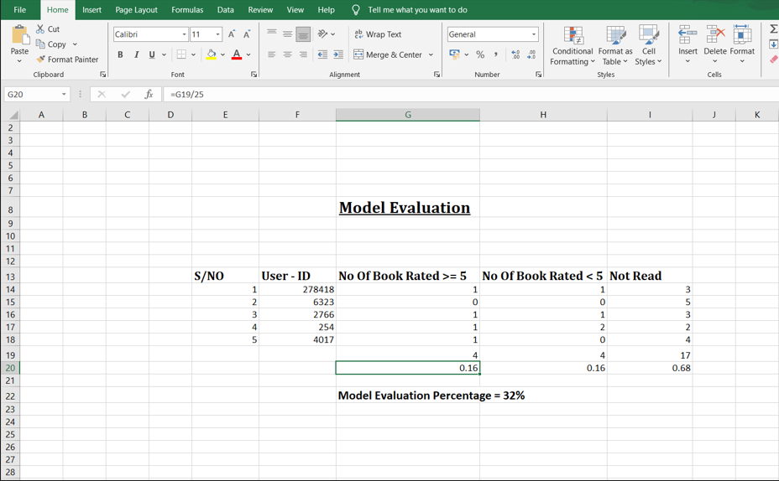
Evaluation

Slide 26
Deployment
Deployment refers to the process of installing, configuring, and making available an application, system, or service in a production environment.
It typically involves the use of specialized tools and techniques to ensure that the deployment is done smoothly, efficiently, and with minimal disruption to users.
In Python , we can achieve the same by using different frameworks
Django
Flask
Streamlit

Slide 27
Deployment using Streamlit in Python

Slide 28
Reasons to use Streamlit
Build an app in few lines of code and with simple API
It doesn’t require any web development knowledge
Deploy the code instantly and see the changes simultaneously by saving the source code
It’s a open source framework

Slide 29
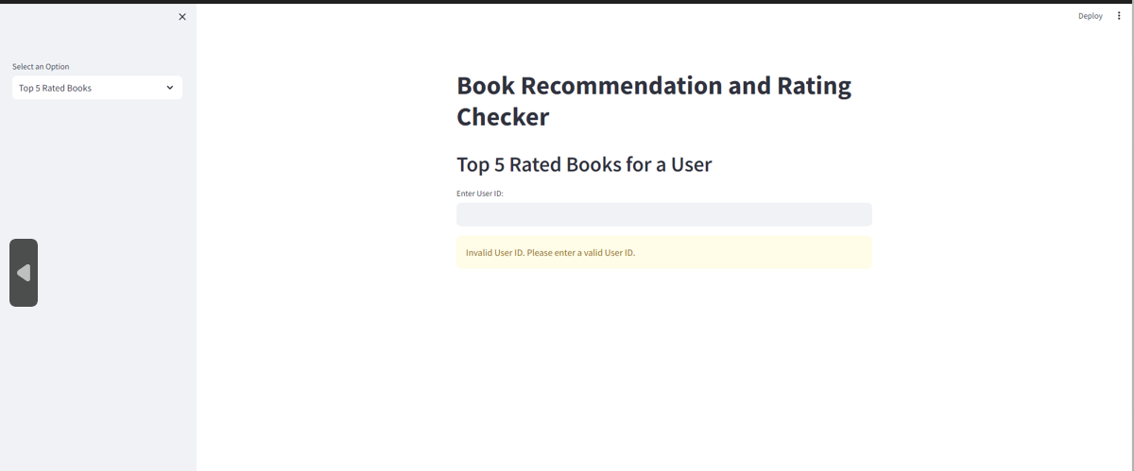
Deployment Process – Deploy 1

Slide 30
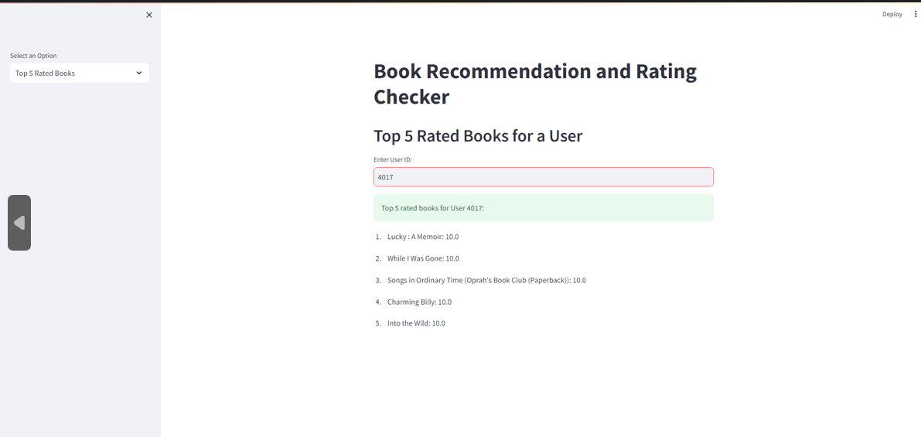
Deployment Process – Deploy 2

Slide 31
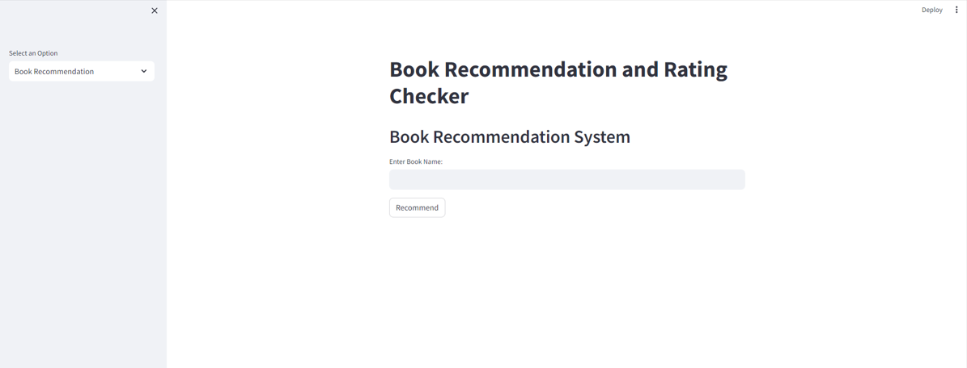
Deployment Process – Deploy 3

Slide 32
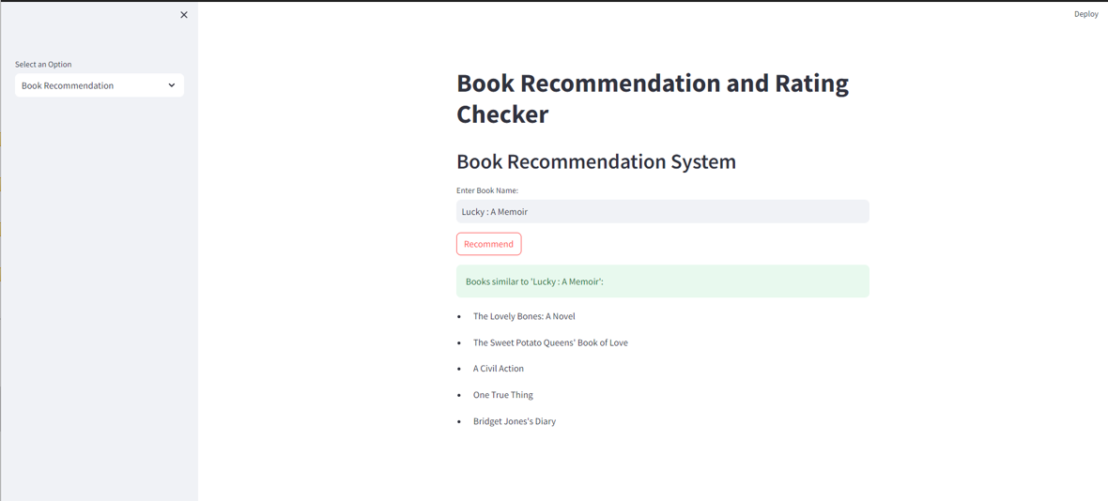
Deployment Process – Deploy 4

Slide 33
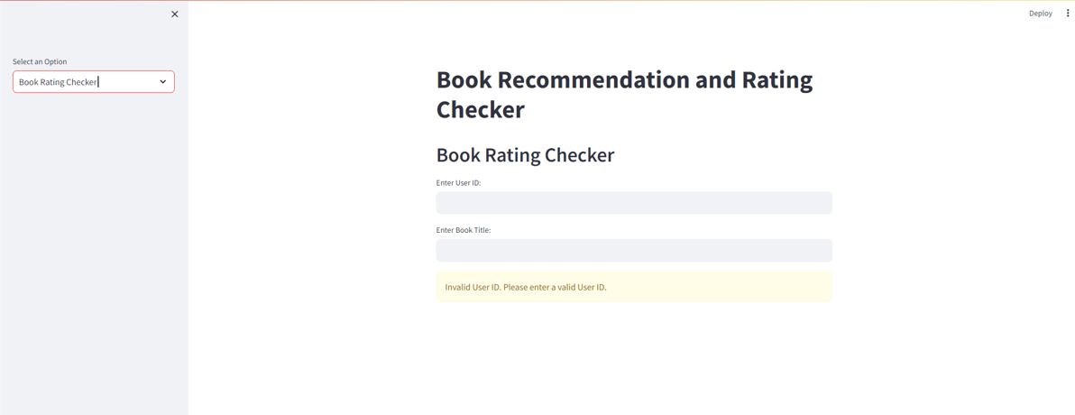
Deployment Process – Deploy 5

Slide 34
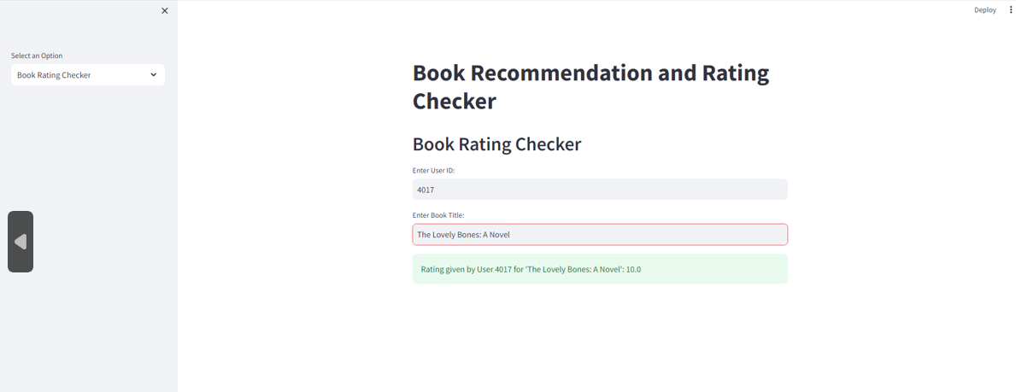
Deployment Process – Deploy 6

Slide 35
Conclusion
● In EDA, the Top-10 most rated books were essentially novels. Books like The Lovely Bone and The Secret Life of Bees were very well perceived.
● Majority of the readers were of the age bracket 20-35 and most of them came from North American and European countries namely USA, Canada, UK, Germany and Spain.
● If we look at the ratings distribution, most of the books have high ratings with maximum books being rated 8. Ratings below 5 are few in number.
● Author with the most books was Agatha Christie, William Shakespeare and Stephen King.
A recommendation system helps an organization to create loyal customers. The recommendation system today are very powerful that they can handle the new customer too who has visited the site for the first time. They recommend the products which are currently trending or highly rated and they can also recommend the products which bring maximum profit to the company.

Slide 36
Challenges
Understanding the metric for evaluation was a challenge as well.
Decision making on missing value imputations and outlier treatment was quite challenging as well.
Since the data consisted of text data, data cleaning was a major challenge in features like Location etc.

Slide 37
Thank you

